Slide 1
Engineering Project Management
Hat 213
Lecture 7:
Management of Engineering Design
and Product Costing
Reference Book: Engineering and Technology Management Tools and Applications
1
Notes:
Dr Mahdi

Slide 2
Management of Engineering Design and Product Costing
Each new engineering product sold is designed within general guidelines such as meeting customer requirements and keeping the product’s selling price within the buying power of the customers.
It means the design of the product must be managed in such a manner that all the necessary design guidelines and other related factors are effectively satisfied.
product costing has become very important to management because an engineering company will venture into developing a new product only if it will generate an acceptable level of profit.
Hence, the cost of various aspects associated with the product must be estimated with care.

Slide 3
Design Types
engineering designs may be grouped under the following three broad classifications:
Developmental design: initiated from the already existing design and may involve a considerable amount of technical work. The final designed product could be different than the original one.
Creative design: This is the design of a completely new item without any precedent whatsoever, and it requires a high degree of competence from the designers.
Adaptive design: This is concerned with adaptation of already existing designs to meet new challenges. Usually, most of the design work undertaken by engineers belongs to this classification.

Slide 4
Design Approach
Perform need analysis: user needs – technical social …etc.
Define the problem: Objectives, boundaries inputs/outputs …etc.
Find effective alternative solutions to the problem.
Perform feasibility analysis of solutions.
Optimize most promising solutions.
Choose the most promising solution.
Implement the most promising solution.
Redesign.

Slide 5
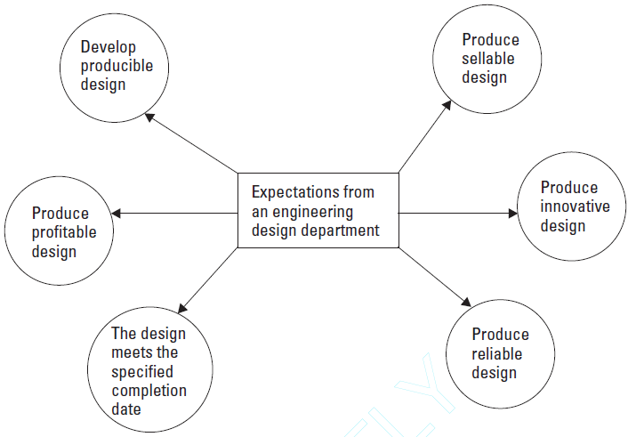
Expectations from a Design Department and Product

Slide 6
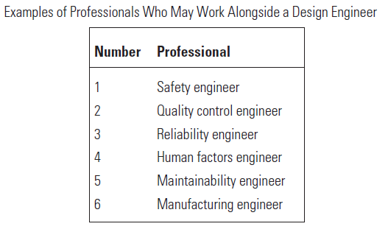
Engineering Design Manpower
Depending on the type and size of an engineering product under design, the professionals involved, along with the design engineer, may vary from one design project to another.

Slide 7
Design Engineer Tasks
Design product.
Optimize the design.
Coordinate the design activity with all concerned individuals.
Participate in design reviews.
Produce new ideas for designs.
Keep abreast of the changing environments and technology.
Keep the design within given constraints.
Record all changes.
Keep management up to date with the design activity.
Answer design-related questions.

Slide 8
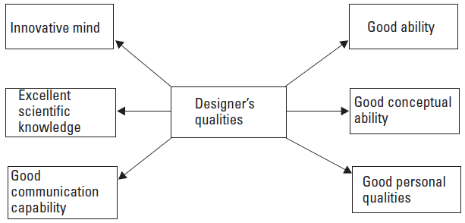
Design Engineer Qualities
Notes:
Good ability means the designer must be able to think logically during
both the preparation of the overall design strategy and the actual design
process. Good conceptual ability is concerned with the designer having the
ability to comprehend and visualize design concepts. Excellent scientific
knowledge means a good designer must possess superior scientific knowledge
in the area of his or her specialization to produce good designs. Some of the
basic areas in which the engineering designer should be well versed include
technical drawings, chemistry, physics, economics, management, elementary
and advanced mathematics, and engineering and technology. An innovative
mind means the designer must possess a creative mind in order to address
technical, economic, and managerial problems.
Good personal qualities include such items as concentration, capability,
integrity, ability to tolerate criticism, perseverance, flexibility, willpower,
good temperament, and good memory. Good communication capability is
concerned with the designer being able to communicate effectively both verbally
and in writing, thus the desired information can be disseminated to
interested parties in an effective manner.

Slide 9
Reasons for Product Costing
Some of the reasons for product costing are:
To determine the most profitable material and procedure for manufacturing a product;
To determine the capital required for equipment and other related items to manufacture a product;
To conduct feasibility analyses of new products;
To measure the efficiency of the product manufacturing process;
To determine the cost-effectiveness of fabricating parts or assemblies or of procuring them from outside agencies;
To establish product price;
To determine the profitability of the product with respect to manufacture and market;

Slide 10
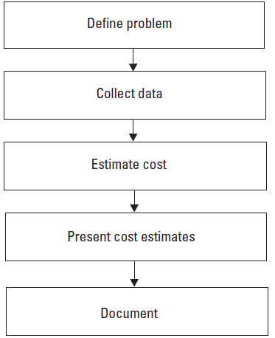
Procedure for Product Costing
define the product or system, collect various types of data that are important to estimate product cost, perform actual cost estimate calculations, present the cost estimates in an easy way to use in making decisions and document the accomplished study.

Slide 11
Product Life Cycle Costing
Today the procurement decisions of many engineering products, particularly the expensive ones, are not entirely made on acquisition costs alone but on their life cycle costs. Experience indicates that the product ownership cost (i.e., logistics and operating cost) can vary from 10 to 100 times the original acquisition cost.
The life cycle cost may simply be defined as the sum of all costs incurred during an item’s life span.
There are various different general and specific models used to estimate life cycle cost, We present just one general model.

Slide 12
General Life Cycle Cost Estimation Model
The life cycle cost of an item is expressed by the equation :
LCC = RC +NRC Where,
LCC is the item life cycle cost.
RC is the item recurring cost. The major components of the recurring cost are labor cost, maintenance cost, inventory cost, support cost, and operating cost.
NRC is the item nonrecurring cost. The components of the nonrecurring cost are research and development cost, acquisition cost, training cost, transportation cost, installation cost, qualification approval cost, and test equipment cost.

Slide 13
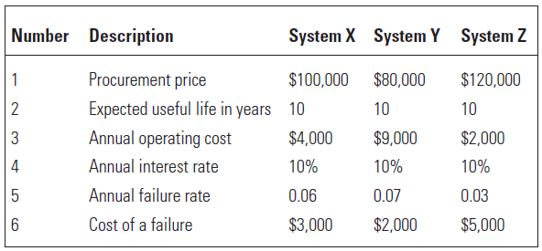
General Life Cycle Cost Example
A company using a system to manufacture certain engineering components is contemplating replacing it with a modern system. Three different systems are being considered for its replacement, and their data are presented in Table. Determine which of the three systems should be procured to replace the existing one with respect to their life cycle costs.

Slide 14







General Life Cycle Cost Example
The Present values of a periodic payment is:
the present value of systems X, Y, Z failure cost over its life span:
Where, X is the principal cost, i annual interest and n years
The annual failure cost of X,Y and Z:

Slide 15
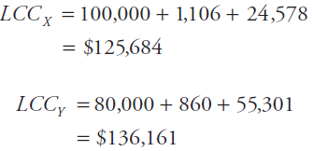




Example Cont.
The present values of systems X, Y, and Z operating costs over their useful life span:
The life cycle costs of systems X, Y, and Z, respectively, are:
By examining the results, it is concluded that system X should be procured because its life cycle cost is the lowest.

Slide 16

Cost Estimation Models
In order to estimate various components of the recurring cost of an item, there are many mathematical models:
MODEL I:
This model is concerned with estimating the labor cost of corrective maintenance:
Where,
LCCM is the labor cost of corrective maintenance.
CML is the cost of maintenance labor per hour.
MTBF is the item’s mean time between failures.
MTTR is the item’s mean time to repair.
Notes:
Example:
Assume that a motor’s mean time between failures and mean time to repair are
1,000 hours and 5 hours, respectively. The estimated annual operating hours
of the motor are 6,000 hours. Calculate the annual corrective maintenance
labor cost of the motor, if the hourly corrective maintenance labor rate is $30.
By substituting the given data into (5.5), we get
LCCM = 30* 6000*(5/1000)= 900$
The annual corrective maintenance labor cost of the motor is $900.

Slide 17

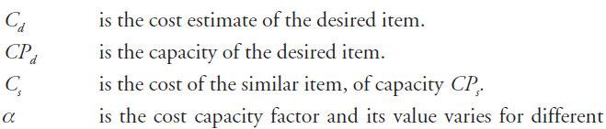
Cost Estimation Models
Model II
This is a very useful model to approximate future cost estimates where cost data are available for similar equipment of a different capacity:
Where,
Notes:
Example:
Assume that the annual maintenance cost of a 10-passenger vehicle is
$1,000. Estimate the annual maintenance cost of a similar 20-passenger vehicle
if the value of the cost capacity factor is 0.7.
C d =1624.5 $

Slide 18
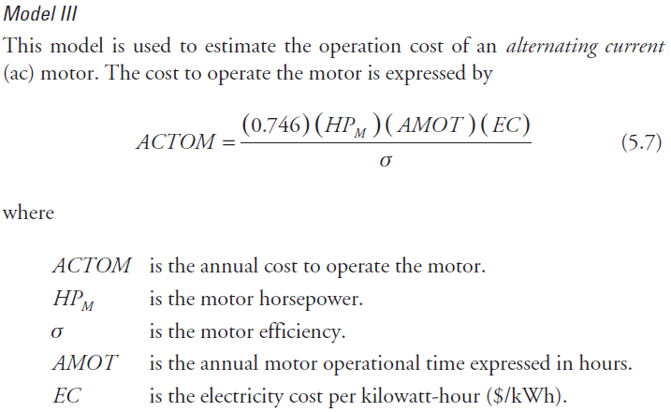
Cost Estimation Models
Notes:
Example 5.4
Assume a 30-horsepower ac motor is operated for 3,000 hours annually. The
motor efficiency and the estimated cost of electricity are 80% and 3 cents per
kilowatt-hour, respectively. Calculate the annual cost of operating the motor.
The annual cost of operating the motor is $2,517.75.

